Slide 1

VIII Semester Major Project Work (22CSP81)
Department of Computer Science,
R V College of Engineering, Bengaluru.

Slide 2

NHI Governance Agent
Umang Mishra (1RV22CS220)
Internship / Inhouse : Honeywell
Internal Guide : Dr Chethana Murthy- Associate Professor
External Guide : Tejeshwar Rao – DevSecOps & Cloud Manager
Date: 09/05/2026
RV COLLEGE OF ENGINEERING

Slide 3
Incorporation of Suggestions
Suggestions from last phase included, adding a detailed architecture diagram, due to uncertainty in the chaining ways by LangChain it was undecided, as we have implemented a good chunk of the chaining, the architecture is a lot clearer now, hence this phase has an in depth explanation of how everything comes together!
Rest of the suggestions were positive and was told that I am on the right track to completion
RV COLLEGE OF ENGINEERING

Slide 4
Level of Complexity
Organizations manage numerous Non-Human Identities (NHIs) across their DevOps ecosystems, these identities are:
Scattered - across multiple platforms (GitHub, Azure, DNS registrars)
Untracked - no centralized visibility into expiry dates, age, scope
Vulnerable - forgotten/rotated credentials create security gaps
Non-compliant - no automated policy enforcement
Manual - monitoring is error-prone and labor-intensive
Task | Description | Complexity
Discovery | Credentials lost across repos, orgs, systems | High
Lifecycle Tracking | No unified age/expiry tracking | High
Risk Assessment | Manual scoring of which identities matter most | Very High
Policy Enforcement | No automated compliance checks | Very High
Reporting | Scattered reports, no unified dashboard | Moderate
Remediation | No actionable insights for fixing issues | High
RV COLLEGE OF ENGINEERING

Slide 5
Level of Complexity
Technical Complexity Indicators:
- Lines of Code: ~2000+ lines across 8 Python modules
- External Integrations: 3 major APIs + LLM service
- Concurrency Requirements: Parallel agent execution
- State Management: Multi-finding aggregation and correlation
- Data Models: 10+ distinct entity type
High-Level Approach Solution
DISCOVERY PHASE → ANALYSIS PHASE → ENFORCEMENT PHASE → REPORTING PHASE
↓ ↓ ↓ ↓
Multi-source Risk Scoring Policy Rules HTML + Dashboard
credential 0-100 scale R001-R007
discovery LLM enrichment Violations
RV COLLEGE OF ENGINEERING

Slide 6
High-Level System Architecture
Block diagram — components and interactions
INPUT SOURCES
GitHub API
PATs, Deploy Keys, Secrets, Workflows
SSL/TLS Domains
Domain List, Ports, SNI Hostnames
Configuration
Thresholds, Policy Rules, LLM Settings, Output Paths
DISCOVERY LAYER (Parallelizable)
cert_agent.py
Connect TLS → Extract Certs → Parse Expiry → Status
Output: [{host, days_left, status, ...}]
github_nhi_agent.py
Query GitHub API → List Repos → Discover PATs/Keys/Secrets
Output: [{nhi_type, scopes, age_days, ...}]
ANALYSIS LAYER
risk_scorer.py
Age(40) + Type(30) + Privilege(20) + SSL(10)
→ Score 0-100, Severity Label
nhi_policies.py
7 Rules: R001–R007
→ Violations[]
LLM Enrichment (GPT-4o)
Optional: score ≥ 50
→ Natural language reasoning
REPORTING LAYER
report_generator.py → HTML + JSON
React Dashboard → 9 Interactive Pages

Slide 7
High-Level System Architecture
Block diagram — components and interactions
INPUT SOURCES
GitHub API
PATs, Deploy Keys, Secrets, Workflows
SSL/TLS Domains
Domain List, Ports, SNI Hostnames
Configuration
Thresholds, Policy Rules, LLM Settings, Output Paths
DISCOVERY LAYER (Parallelizable)
cert_agent.py
Connect TLS → Extract Certs → Parse Expiry → Status
Output: [{host, days_left, status, ...}]
github_nhi_agent.py
Query GitHub API → List Repos → Discover PATs/Keys/Secrets
Output: [{nhi_type, scopes, age_days, ...}]
ANALYSIS LAYER
risk_scorer.py
Age(40) + Type(30) + Privilege(20) + SSL(10)
→ Score 0-100, Severity Label
nhi_policies.py
7 Rules: R001–R007
→ Violations[]
LLM Enrichment (GPT-4o)
Optional: score ≥ 50
→ Natural language reasoning
REPORTING LAYER
report_generator.py → HTML + JSON
React Dashboard → 9 Interactive Pages

Slide 8
Risk Scoring Calculation Algorithm
Deterministic scoring 0-100 with severity labeling
40 pts
Age Component
age_ratio = min(age / max_age, 1.0) × 40
Severity Classification
CRITICAL — score ≥ 70
30 pts
Type Weight
PAT=30 DK_Write=30 DK_Read=18 Secret=14 SSL=10
HIGH — score ≥ 50
20 pts
Privilege Scope
20 if write/admin scope, 10 if read-only
MEDIUM — score ≥ 30
10 pts
SSL Bonus
10 if CRITICAL, 5 if WARNING, 0 otherwise
LOW — score < 30
Worked Example
PAT, 180 days old, admin:org scope
Age: min(180/30, 1) × 40 = 40
Type: PAT = 30
Priv: admin:org → 20
SSL: N/A → 0
─────────────────────
Total = 90 → CRITICAL
Total = Age + Type + Privilege + SSL (capped at 100)

Slide 9
1. Type Weight (30 pts maximum)
Based on the NHI credential type:
PAT (Personal Access Token): 30 pts
DEPLOY_KEY_WRITE (write access): 30 pts
DEPLOY_KEY_READ (read-only): 18 pts
ACTIONS_SECRET: 14 pts
SSL_CERT: 10 pts
2. Age Component (40 pts maximum)
Mesures how old the credential is relative to policy thresholds:
Scales linearly from 0 pts (new) to 40 pts (at threshold age)
For example, a PAT created 30 days ago with a 30-day policy threshold gets 40 pts
Examples:
Actions secrets: max 90 days policy
Deploy key write: max 60 days policy
Deploy key read: max 120 days policy
3. Privilege Scope (20 pts maximum)
For PATs, counts high-privilege scopes like:
repo, admin:org, workflow, delete_repo, write:packages
Each high-privilege scope adds 7 pts (capped at 20 pts)
Write access adds bonus points
For Deploy Keys, +20 pts if it has write (push) access
4. SSL Certificate Severity (up to 90 pts additional)
EXPIRED/ERROR: +90 pts (automatic CRITICAL)
CRITICAL status: +40 pts (expires within red threshold, default 30 days)
WARNING status: +20 pts (expires within yellow threshold, default 60 days)
Severity Labels
CRITICAL: Score ≥ 70
HIGH: Score ≥ 50
MEDIUM: Score ≥ 30
LOW: Score < 30
The final score is capped at 100, then sorted descending with all findings combined. Optionally, GPT-4o can enrich high-scoring findings (default: ≥50) with natural language risk summaries.

Slide 10
State Diagrams
Finding lifecycle & system execution states
Finding State Lifecycle
System Execution State Machine
DISCOVERY
Raw Finding: host, status, no score
IDLE
Waiting for user input
INITIALIZATION
Load config, init agents, setup LangChain
SCORING
Scored Finding: +score (0-100), +severity
DISCOVERY
SSL + GitHub checks (parallel, timeouts)
ENRICHMENT
Enriched Finding: +risk_reason (LLM)
ANALYSIS
Scoring + policy evaluation
ENRICHMENT
LLM (GPT-4o)
REPORTING
Reported Finding: in HTML, JSON, Dashboard
REPORTING
Generate HTML + JSON
COMPLETE → IDLE
Report path returned

Slide 11
Sequence Diagram — Full Orchestration
UML Sequence: actors, messages, and timeline
User
Orchestrator
CertAgent
GitHubAgent
RiskScorer
PolicyEngine
ReportGen
invoke scan
load config.yaml
SSLCertCheck (parallel)
GitHubNHIDiscovery (parallel)
cert_findings[]
nhi_findings[]
score(merged_findings)
scored_findings[]
evaluate(scored)
violations[]
GPT-4o enrich (if enabled)
generate(findings, violations)
report_path
return HTML path

Slide 12
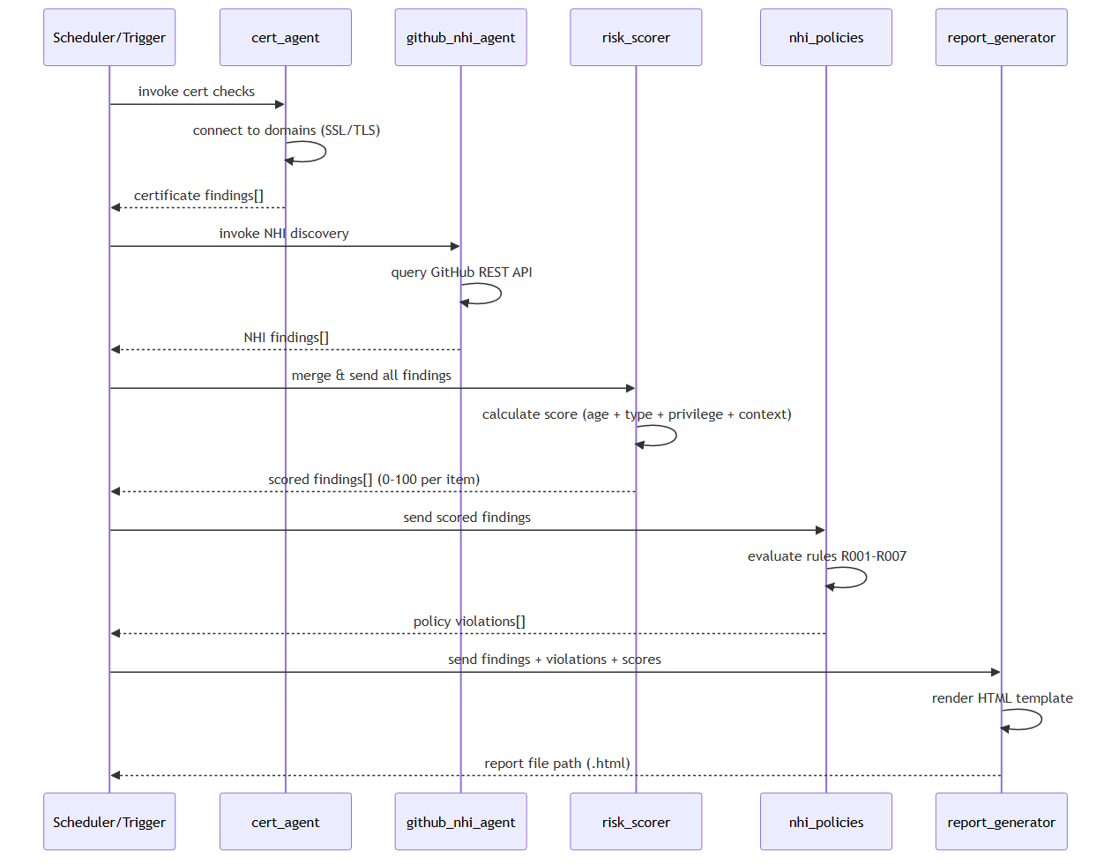

Slide 13
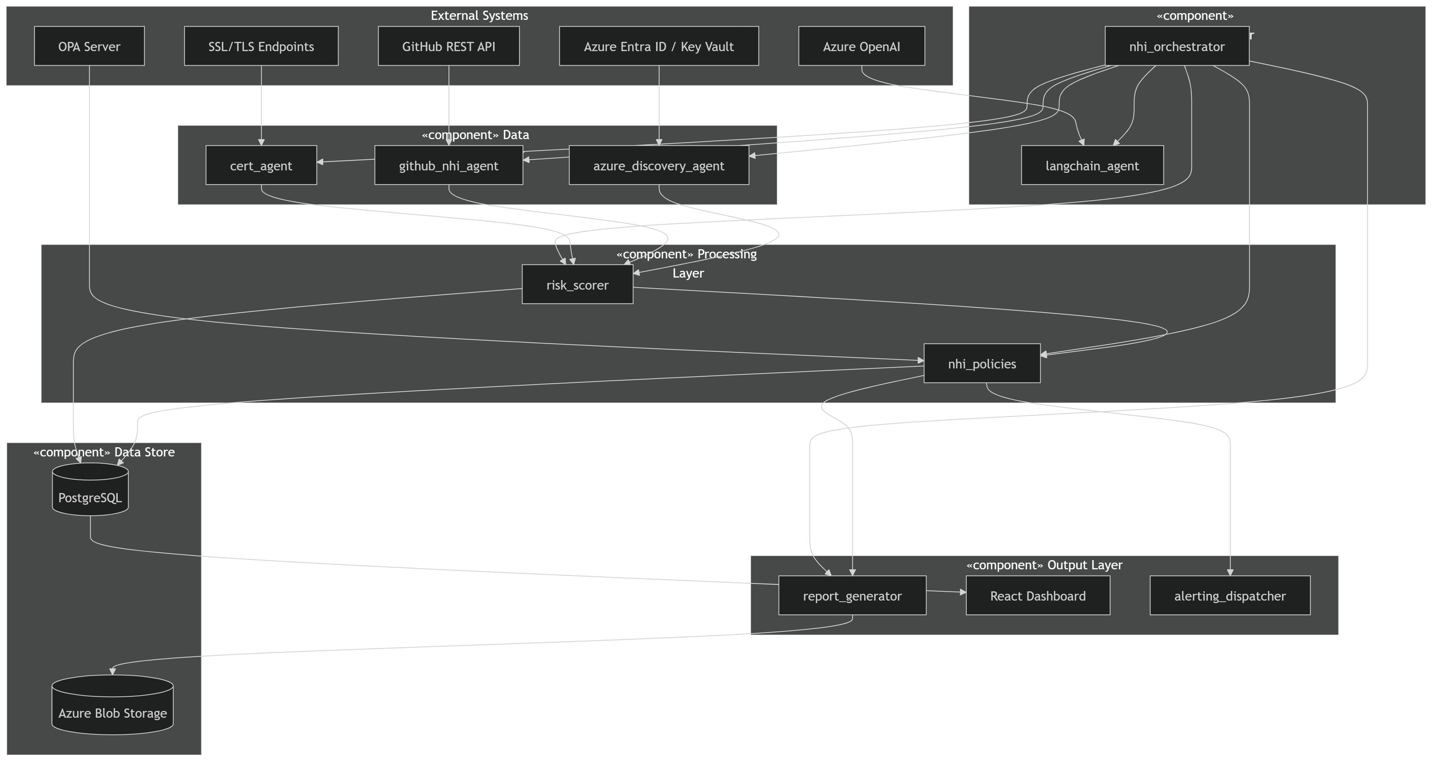
UML Class Diagram
Key data models and their relationships

Slide 14
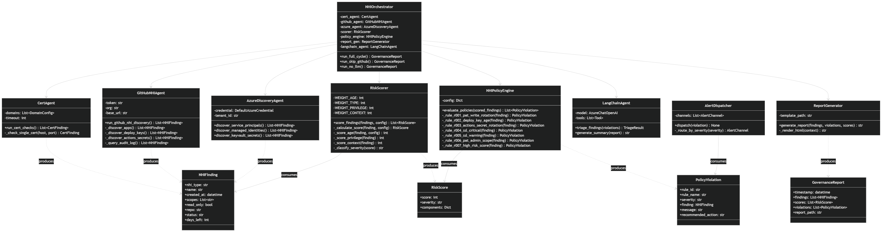
UML Component Diagram
System components, interfaces, and dependencies

Slide 15
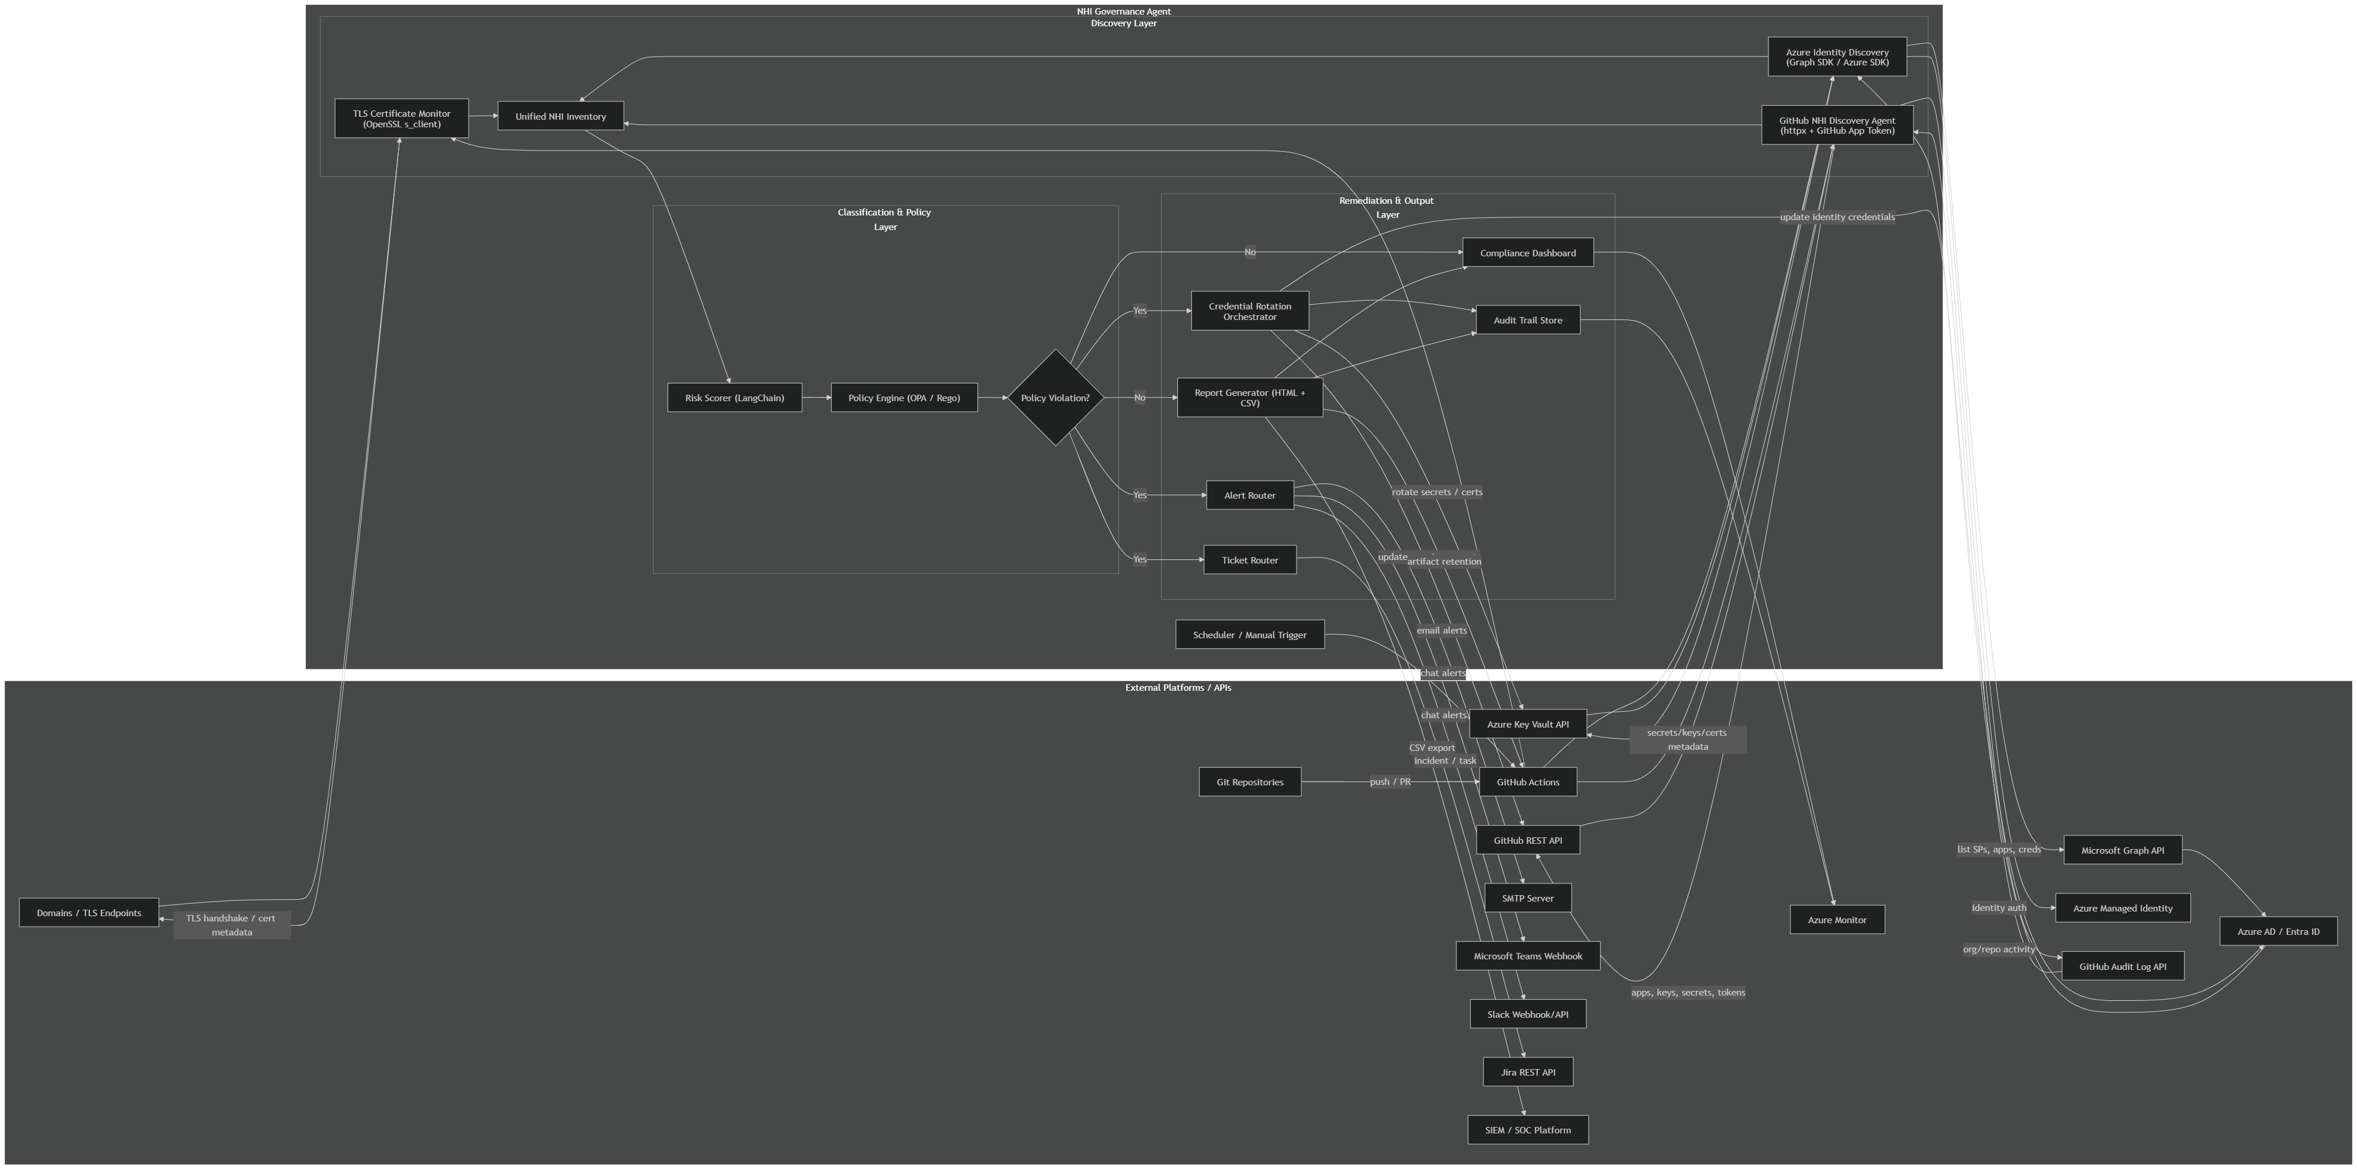
API Integration Diagram

Slide 16
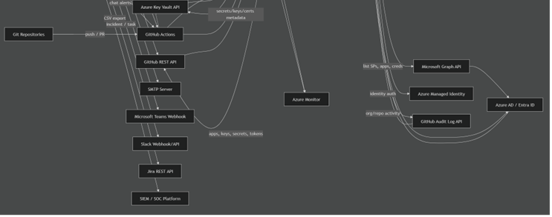

Slide 17
┌────────────────────────────────────┐
│ python orchestrator/nhi_orchestrator.py
──────────────┬──────────────────────┘
│
▼
┌───────────────────┐
│ main() function │
│ parse_arguments() │
└─────────┬─────────┘
│
▼ (skip_github=False, llm_enabled=False)
┌──────────────────────┐
│ run_direct_mode() │
└─────────┬────────────┘
│
┌──────────┼──────────┬──────────┬──────────┐
│ │ │ │ │
▼ ▼ ▼ ▼ ▼
[1/4] [2/4] [3/4] [4/4] Summary
run_cert_ run_github score_ evaluate Generation
checks() nhi_ findings policies()
discovery() ()
│ │ │ │
└──────────┴──────────┴──────────┴──────────┐
│
┌─────────────▼──────────────┐
│ Save to nhi_inventory.json │
│ Generate HTML report │
│ Print summary │
│ Exit (0 or 1) │
└────────────────────────────┘

Slide 18
SRS Traceability Matrix
Requirements mapped to design components
SRS Requirement
Design Component
Implementation
Verification
FR-01: Discover SSL certs
Discovery Layer
cert_agent.py
SSL scan output
FR-02: Discover GitHub NHIs
Discovery Layer
github_nhi_agent.py
NHI findings list
FR-03: Risk scoring
Analysis Layer
risk_scorer.py
Score 0-100 + severity
FR-04: Policy evaluation
Analysis Layer
nhi_policies.py
Violations report
FR-05: LLM enrichment
Analysis (optional)
risk_scorer.py + OpenAI
risk_reason field
FR-06: HTML reporting
Reporting Layer
report_generator.py
HTML file generated
FR-07: JSON inventory
Reporting Layer
report_generator.py
nhi_inventory.json
FR-08: Orchestration
Orchestration
nhi_orchestrator.py
End-to-end scan
FR-09: Dashboard UI
Presentation
React dashboard (9 pages)
Visual verification
NFR-01: No hardcoded secrets
All modules
Env vars + config.yaml
Code review
NFR-02: Configurable thresholds
config.yaml
YAML-driven agents
Config validation

Slide 19
Non-Functional Requirements
Performance, scalability, and security considerations
Performance
• Parallel discovery: cert + GitHub agents run concurrently
• SSL connect timeout: 10s per domain (configurable)
• GitHub API timeout: 60s for full repo scan
• LLM enrichment timeout: 120s (optional, skippable)
Scalability
• Modular agent design — add new NHI sources easily
• Config-driven: adjust thresholds without code changes
• JSON output enables downstream pipeline integration
• Docker deployment for horizontal scaling
Security
• No hardcoded credentials — env vars for tokens
• GitHub token: minimum read:repo scope
• LLM: only high-risk findings sent to API (score ≥ 50)
• Reports stored locally; no data exfiltration
Reliability & Maintainability
• Demo mode for testing without external dependencies
• Graceful error handling with timeout fallbacks
• Report archival with configurable max_reports limit
• Policy engine structured for OPA Rego migration

Slide 20
Implementation Level
The Identity Governance System has transitioned from design to a functional implementation
Where core modules like the `github_nhi_agent.py` and `cert_agent.py` successfully discover credentials, while the `risk_scorer.py` and `nhi_policies.py` modules translate the theoretical 0–100 risk formula and seven governance rules (R001–R007) into deterministic Python logic.
The system utilizes a modern stack—including Python for the backend, React for the dashboard, and LangChain for LLM orchestration—to show full integration through the `nhi_orchestrator.py`, which sequences the pipeline from multi-level data discovery to the generation of visual HTML reports and structured JSON inventories
Evidence of this implementation is visible in the provided code snippets for automated policy enforcement and the rendered Mermaid architecture diagrams, demonstrating a working system where heterogeneous API data is successfully synthesized.
RV COLLEGE OF ENGINEERING

Slide 21
Thank you
RV COLLEGE OF ENGINEERING

